Slide 1
Update: Piezo-energy harvesting
Chongan Wang
2024-12-20

Slide 2
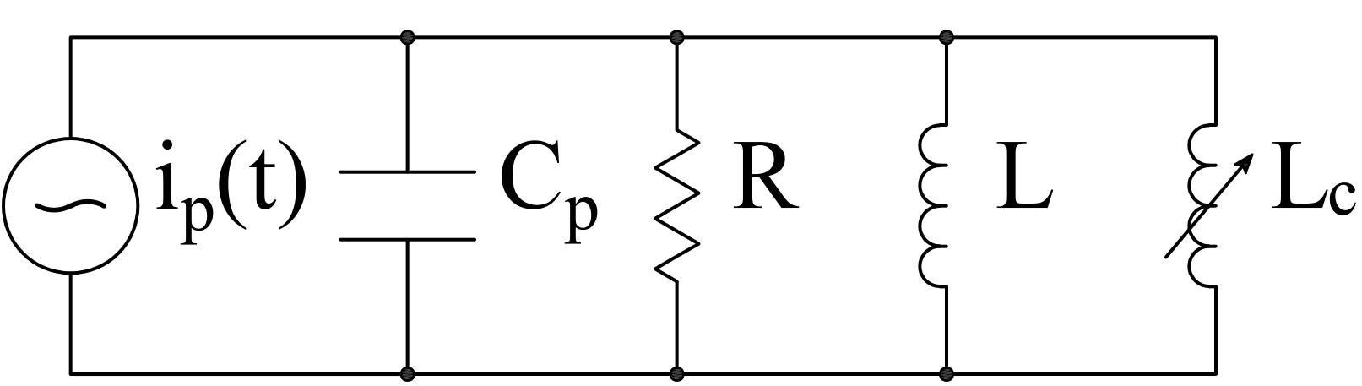
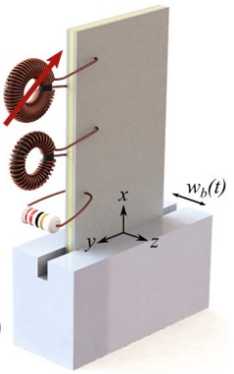

Schematic
$$v\left(t\right)$$
We consider two piezoelectric patches
A voltage signal is applied on the piezoelectric patch near the tip
The piezoelectric patches near the base is shunted by the following nonlinear circuit
Previous work in Obaidullah’s paper

Slide 3




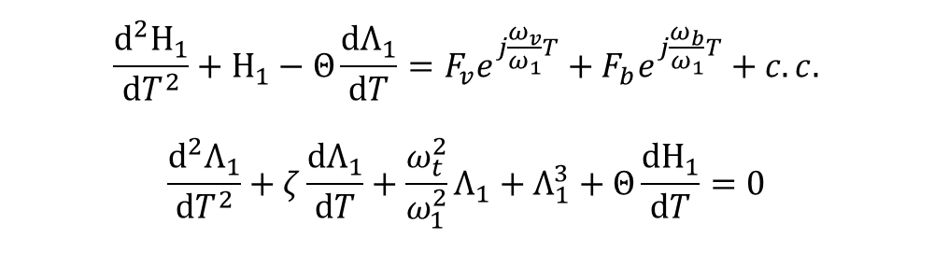
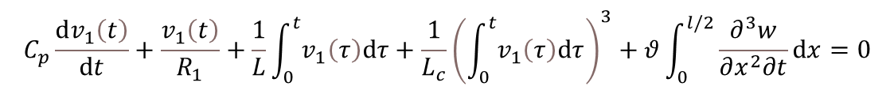
Analytical Foundation – a Review
$$−\frac{∂^{2}M}{∂x^{2}}+m\frac{∂^{2}w}{∂t^{2}}=0$$
$$x=l$$
Governing equations:
$$M=−YI\frac{∂^{2}w}{∂x^{2}}+θv_{1}\left(t\right)\left[H\left(x\right)−H\left(x−\frac{l}{2}\right)\right]+θv_{2}\left(t\right)\left[H\left(x−\frac{l}{2}\right)−H\left(x−l\right)\right]$$
$$v\left(t\right)$$
$$C_{p}\frac{dv_{1}\left(t\right)}{dt}+\frac{v_{1}\left(t\right)}{R_{1}}+\frac{1}{L}\int_{0}^{t}{v_{1}\left(τ\right)dτ}+\frac{1}{L_{c}}{\left(\int_{0}^{t}{v_{1}\left(τ\right)dτ}\right)}^{3}+θ\int_{0}^{l/2}{\frac{∂^{3}w}{∂x^{2}∂t}dx}=0$$
$$x=\frac{l}{2}$$
Normalized ROM
$$\frac{d^{2}Η_{1}}{dT^{2}}+Η_{1}−Θ\frac{dΛ_{1}}{dT}=F_{v}e^{j\frac{ω_{v}}{ω_{1}}T}+F_{b}e^{j\frac{ω_{b}}{ω_{1}}T}+c.c.$$
$$\frac{d^{2}Λ_{1}}{dT^{2}}+ζ\frac{dΛ_{1}}{dT}+\frac{ω_{t}^{2}}{ω_{1}^{2}}Λ_{1}+Λ_{1}^{3}+Θ\frac{dΗ_{1}}{dT}=0$$

Slide 4

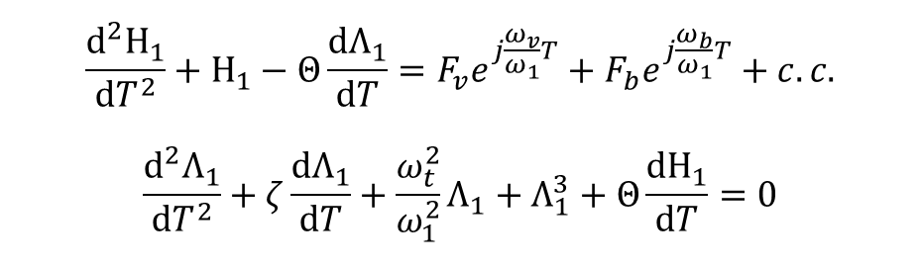




Hysteresis Loop and Responses
$$\frac{d^{2}Η_{1}}{dT^{2}}+Η_{1}−Θ\frac{dΛ_{1}}{dT}=F_{v}e^{j\frac{ω_{v}}{ω_{1}}T}+F_{b}e^{j\frac{ω_{b}}{ω_{1}}T}+c.c.$$
$$\frac{d^{2}Λ_{1}}{dT^{2}}+ζ\frac{dΛ_{1}}{dT}+\frac{ω_{t}^{2}}{ω_{1}^{2}}Λ_{1}+Λ_{1}^{3}+Θ\frac{dΗ_{1}}{dT}=0$$
$$2w_{0}=1μm$$
$$F_{b}=−0.0146$$
$$2v_{0}=1V$$
$$F_{v}=0.0052$$
Plot $\left(F_{v}e^{j\frac{ω_{v}−ω_{b}}{ω_{1}}T}+F_{b}\right)e^{j\frac{ω_{b}}{ω_{1}}T}+c.c.$ versus $T$
Previous simulations in ROM reveal that we can excite the higher order branch

Slide 5
Further Discussion in the Previous Meeting
Can we increase the modulation frequency of the excitation
Robustness
Random source of ambient vibration (future prospect)
In these slides, I will show some FEM simulation results of the beam harvester
These results can confirm our ROM, or illustrate what’s missing in the ROM
Further numerical analysis should rely on the full elastodynamics simulation, not the ROM

Slide 6
FEM Discretization and integration
$$−\frac{∂^{2}M}{∂x^{2}}+m\frac{∂^{2}w}{∂t^{2}}=0$$
Governing equations:
$$M=−YI\frac{∂^{2}w}{∂x^{2}}+θv_{1}\left(t\right)\left[H\left(x\right)−H\left(x−\frac{l}{2}\right)\right]+θv_{2}\left(t\right)\left[H\left(x−\frac{l}{2}\right)−H\left(x−l\right)\right]$$
$$v\left(t\right)$$
$$C_{p}\frac{dv_{1}\left(t\right)}{dt}+\frac{v_{1}\left(t\right)}{R_{1}}+\frac{1}{L}\int_{0}^{t}{v_{1}\left(τ\right)dτ}+\frac{1}{L_{c}}{\left(\int_{0}^{t}{v_{1}\left(τ\right)dτ}\right)}^{3}+θ\int_{0}^{l/2}{\frac{∂^{3}w}{∂x^{2}∂t}dx}=0$$
We discretize the beam with 40 beam elements
Resulting equations:
$$\left[M\right]\ddot{x}+\left[C\right]\dot{x}+\left[K\right]x+f_{nl}\left(x\right)=F\left(t\right)$$
Integration scheme: Newmark-beta
At each step, the Newton-Ralphson method is used to solve the resulting nonlinear algebraic equation

Slide 7
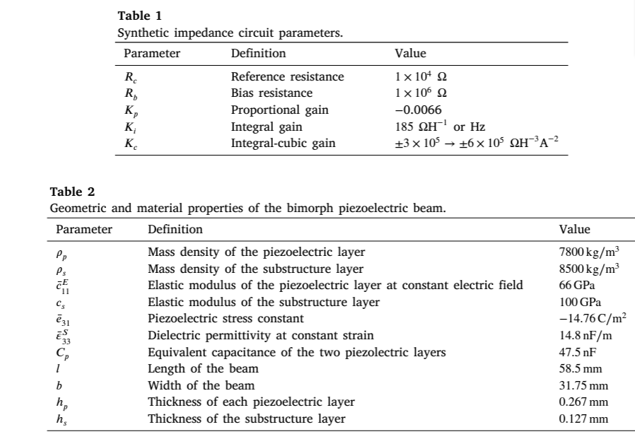
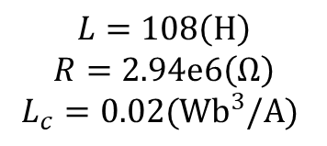

Results
$$v\left(t\right)=2v_{0}\sin\left(ω_{v}t\right);w_{b}=2w_{0}\cos\left(ω_{b}t\right)$$
We consider previous simulation parameters
$$v\left(t\right)$$
$$K_{i}=185/2$$
$$L=108\left(H\right)$$
$$R=2.94e6\left(Ω\right)$$
$$L_{c}=0.02{(Wb}^{3}/A)$$

Slide 8

Results
$$v\left(t\right)=2v_{0}\sin\left(ω_{v}t\right);w_{b}=2w_{0}\cos\left(ω_{b}t\right)$$
$$v\left(t\right)$$
ROM reveals that we should hit the higher branch, however we are actually hitting the lower branch from FEM
$$L=108\left(H\right)$$
$$R=2.94e6\left(Ω\right)$$
$$L_{c}=0.02{(Wb}^{3}/A)$$

Slide 9

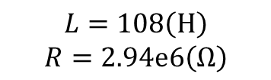
Results
$$v\left(t\right)=2v_{0}\sin\left(ω_{v}t\right);w_{b}=2w_{0}\cos\left(ω_{b}t\right)$$
$$v\left(t\right)$$
$$L_{c}=0.018{(Wb}^{3}/A)$$
Higher nonlinearity
ROM reveals that the higher branch is excited, but FEM reveals the transition from lower branch to higher branch.
$$L=108\left(H\right)$$
$$R=2.94e6\left(Ω\right)$$

Slide 10

Results
$$v\left(t\right)=2v_{0}\sin\left(ω_{v}t\right);w_{b}=2w_{0}\cos\left(ω_{b}t\right)$$
$$v\left(t\right)$$
$$L_{c}=0.022{(Wb}^{3}/A)$$
Lower nonlinearity
ROM reveals the transition from lower branch to higher branch, but FEM reveals that the lower branch is excited.
$$L=108\left(H\right)$$
$$R=2.94e6\left(Ω\right)$$

Slide 11
Concluding Remarks
The continuous model verified the transition from lower to higher branch
The threshold of nonlinearity seems to be deviated from that predicted in ROM
Further investigations is needed for continuous models (energy, power flow etc.) to confirm its validity
In my perspective, the disparity occurs since the beam does not vibrates at its first mode. Specifically, the piezoelectric patches will significantly affect its vibration mode, and the approximation is inaccurate.

Slide 12
Next step
Remove nonlinearity to check the validity of the FEM
Study how nonlinearity affects the effective damping etc.
My hypothesis: The estimation of the first electro-mechanical mode from the ROM is slightly greater than then actual frequency of the first mode.

